Slide 1
North Seattle College
Fire Science
Megan Bloomingdale
Program Name
Goes Here
Presenter Name Goes Here
Notes:
Welcome, introduce yourself and the program. Feel free to share about your education/career background, how long you’ve been teaching, etc.

Slide 2
What is the program?
This two-year (full-time) program of study prepares students for a career in the fire service, as well as for career advancement. The degree will prepare students for the testing (Work Attitudes and FireTEAM tests), assessment (oral board exam), and pre-employment screening process for hiring by fire departments as a firefighter candidate, ready to engage in recruit training. It will also enable current firefighters to qualify for career advancement opportunities.
When is this program offered?
Starting Fall 2021
Entry Requirements
Enrollment at NSC College

Slide 3
What is the program?
This degree program helps build the foundation of the skills needed to build or enhance fire service career. By utilizing a comprehensive curriculum taught by subject matter experts, this program meets the academic and career needs for both those who want to enter the field and those who are looking to advance in their careers
Notes:
3

Slide 4
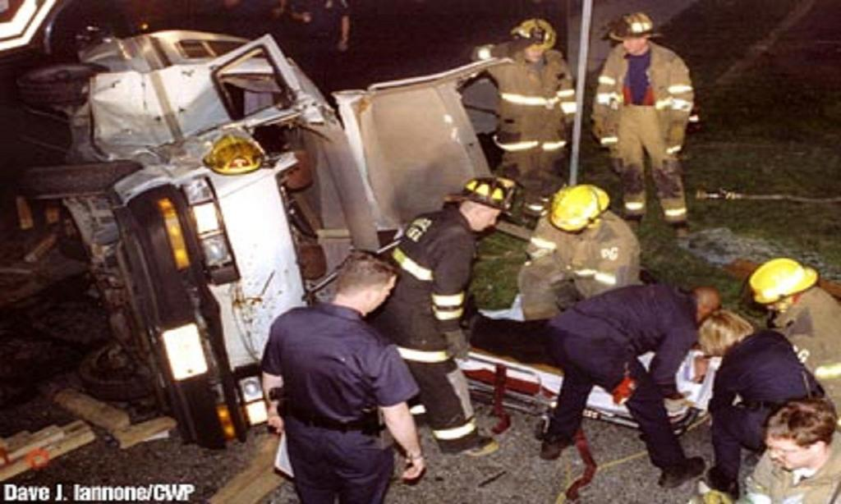
What do you learn?
Notes:
4

Slide 5
What do you learn?
Course Number | General Education/Related Instruction Requirements (25 credits) | Credit Hours
ENGL&101* | English Composition (or other approved Communications course) | 5
MATH&146* | Quantitative Reasoning (Recommend MATH&146 or MATH&107) | 5
BIOL or CHEM | Natural World Course (Recommend Biology or Chemistry Lab course) | 5
BUS 236 | Interpersonal Communications for the Workplace (or other approved Human Relations Course) | 5
(HUM 105) US Culture or Global Studies | Intercultural Communication (or other 5-credit course selected from a list of approved US Cultures or Global Studies courses) | 5
Course Number | Core Degree Requirements (63 credits)
FIRE 101 | Principles of Emergency Services | 5
FIRE 102 | Fire Behavior and Construction | 5
FIRE 103 | Building Construction for Fire Protection | 5
FIRE 104 | Principles of Fire and Emergency Services Safety and Survival | 5
FIRE 105 | Fire Prevention | 5
FIRE 106 | Legal Aspects of Emergency Services | 5
FIRE 107 | Fire Protection Systems | 5
FIRE 108 | Principles of Fire and Emergency Services Administration | 5
FIRE 109 | Occupational Safety and Health for Emergency Services | 5
FIRE 110 | Strategy and Tactics | 5
AHE 190 & AHE 192 | Emergency Medical Technician Certificate | 13
CWE 110 | Internship or Practicum (could include an internship, fire service experience, a project at an ambulance employer, military experience, etc.) | 3
Total Units: 91 (excluding pre-requisites)
Notes:
5

Slide 6
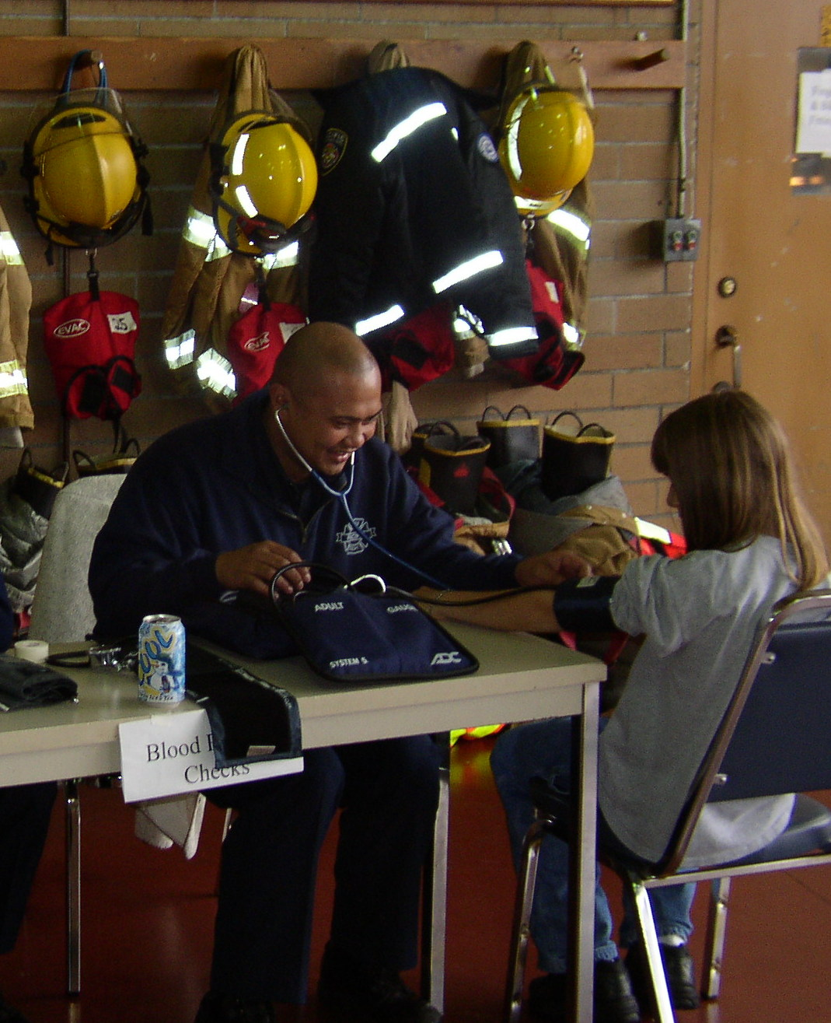
What do you learn?
The program includes an internship component that will give graduates experience they can highlight when applying for firefighter positions. North Seattle College is developing internship opportunities with the Seattle Fire Department and other area fire services for Fire Science students.
Notes:
6

Slide 7
Education Pathway
The curriculum is based on the National Fire Academy Fire and Emergency Services Higher Education (FESHE) model curriculum for fire science. Students will graduate with the academic credentials necessary to enter a two-year baccalaureate of applied science degree program, such as the online Homeland Security Emergency Management program or the Fire Science Leadership Management program at Pierce College.
Fire – North Seattle College Fire Science Associate Degree
Homeland Security Emergency Management program
Fire Science Leadership Management program at Pierce College.

Slide 8
EMT
North’s 13-credit, one-quarter EMT certificate includes the lectures and practice/labs required for certification. The program is rigorous, but upon completion you’ll be qualified to take the National Registry Exam for certification and are immediately eligible to seek employment. The program is approved by Washington State Dept of Health and the National Registry of Emergency Medical Technicians.
When is this program offered?
Every quarter
Entry Requirements
At least 18 years old
High School Graduate or equivalent
Clean Background Check
To work must have WA Driver’s license
Notes:
8

Slide 9
Where do EMTs work?
Fire Departments
Police Departments
Search and Rescue
Ski Patrol
Ambulances
Emergency Departments
Clinics
Notes:
9

Slide 10
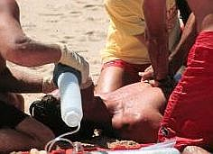
EMT
Patient Assessment
Vital Signs
CPR / AED
Oxygen Therapy
Medication Administration
Bleeding Control
Splinting
Extrication
Spinal Immobilization
Backboarding
KED
Notes:
10

